Slide 1
Heuristics for Rich VRP Models
Geir Hasle Ph.D.
Senior Scientist, Department of Optimization, SINTEF Applied Mathematics
Assistant Professor, Department of Informatics, University of Oslo
ROUTE2003
Skodsborg, Denmark June 24 2003

Slide 2
Outline
Introduction
  VRP and Variants
Context
  Ongoing Research in TOP Program
Industrial VRPs and Rich Models
A Generic VRP Solver
  VRP Model
  Algorithmic Approach
  Results on PDPTW
Summary and Conclusions

Slide 3
The VRP
Designing a set of least cost routes for a fleet of vehicles from depots in order to service a number of transportation demands
Many types of application
Distribution of goods
Local pickup and delivery
Transportation of people with vans
Repairmen
Garbage collection, gritting, snow removal
VRP models in OR
  tend to be based on a number of crucial assumptions
  many variants

Slide 4
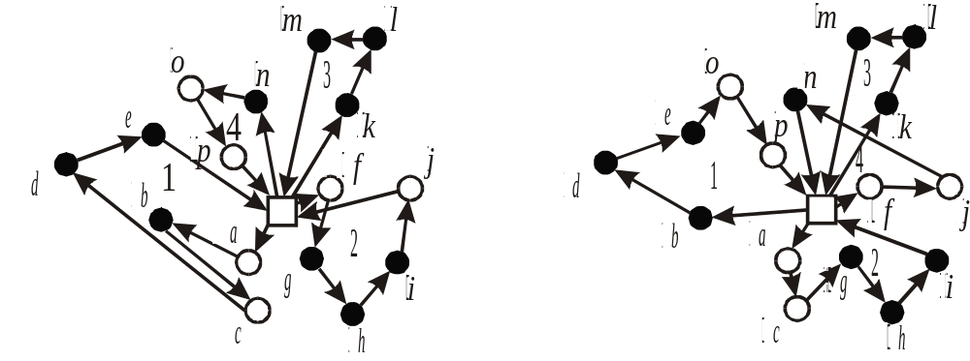
The Capacitated VRP (CVRP) and variants
Graph G=(N,A)
  N={0,…,n+1} vertex set
  0 Depot, i≠0 Customer
  A={(i,j): i,j∈N} Arc Set
  c_{ij} >0 Travel Cost
Demand d_{i} for each Customer i
V set of identical Vehicles each with Capacity q
Goal
  Design least Cost set of Routes, starting and ending at Depot
  Each Customer visited exactly once (no splitting)
  Total Demand for all Customers on any route within Capacity
  Minimize Cost : weighted sum of Travel Cost and #Routes
DVRP – distance constrained VRP
VRPTW – VRP with time windows
Pickup/delivery
  Backhaul – VRPB(TW)
  Pickup and delivery VRPPD(TW)

Slide 5
Complexity of VRP(TW) and
State-of-the-art: Exact Methods
Basic VRP
  Strongly NP-hard
  Branch and Bound, basic relaxations
  Lagrangean Relaxation
  Set Partitioning
  Branch and Cut
  Consistently solves 50 customer problem instances
VRPTW: finding a feasible solution is NP-complete
  Dantzig-Wolfe decomposition
    typical subproblem: SPP with capacity and time windows
  Lagrangean Relaxation
  Consistently solves 100 customer problem instances

Slide 6
VRP Literature
VRP introduced by Dantzig and Ramser 1959
Huge literature, surveys
  Golden and Assad (1986)
  Desrochers et al. (1988)
  Golden and Assad (1988)
  Solomon and Desrosiers (1988)
  Desrosiers et al. (1995)
  Cordeau et al. (2001a)
G. Laporte, I. Osman: Routing Problems: A Bibliography. Ann. OR 61, 1995
Bräysy, Gendreau: Route Construction and Local Search Algorithms for the Vehicle Routing Problem with Time Windows, SINTEF Report STF42 A01024, Department of Optimization, Oslo, Norway, 2001
Bräysy, Gendreau: Metaheuristics for the Vehicle Routing Problem with Time Windows. SINTEF Report STF42 A01025, Department of Optimization, Oslo, Norway, 2001.
Toth & Vigo: The Vehicle Routing Problem, SIAM Monographs 2002
O. Bräysy, M. Gendreau, G. Hasle, A. Løkketangen: A Survey of Rich Vehicle Routing Models and Heuristic Solution Techniques, Draft Technical Report, SINTEF 2002

Slide 7
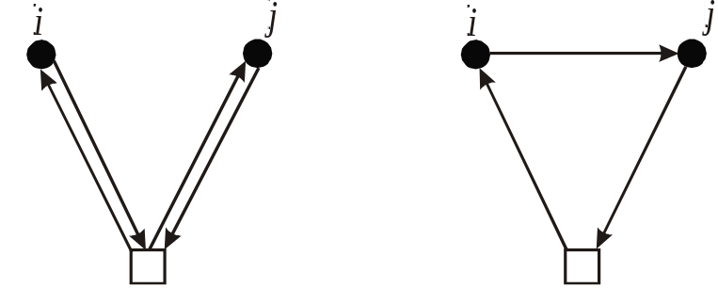
Classical Heuristics for the VRP (1960-1995)
Constructive Heuristics
  Savings (Clarke and Wright, 1964)
  Insertion Heuristics
  Sequential vs. Parallel versions
Two-phase heuristics
  Cluster-First-Route-Second
  Route-First-Cluster-Second
Improvement
  Single Route (λ−Opt, other TSP improvement operators)
  Multiple Route (Relocate, Cross, Exchange, ..)
  Descent
Limited Exploration of Search Space
Local Optima
Fast
Good quality (within 7% of best known), limited potential
Extendible to Real Life Models
Widely Used in Commercial Routing Software

Slide 8
Modern Heuristics for VRP (1990 ->)
Construction + Iterative Improvement
Local (Neighborhood) Search
Metaheuristics
  Strategies to avoid local optima
  Diversification
  Intensification
Simulated Annealing / Deterministic Annealing
Tabu Search / Guided Local Search
Variable Neighborhood Search (VNS)
Genetic Algorithms / Evolutionary Methods
Ant Colony Optimization
Artificial Neural Networks
Hybrid methods

Slide 9
Modern Heuristic Methods
Better solutions
Near optimal solutions for several hundred customer instances, reasonable time
More time consuming
More tuning
Harder to extend

Slide 10
Real-life Applications need Richer Models
Types of Operation, Services
  multiple depots
  mix of pickup and delivery
  order splitting
  arc routing
Constraints
  capacity
  time windows
  precedences
  (in)compatibilities
Objective
  multiple components
  soft constraints
Numerous Extensions in the literature

Slide 11

Extensions in the VRP Literature
Location Routing LRP
Fleet Size and Mix FSMVRP
VRP With Time Windows VRPTW
General Pickup and Delivery GPDP
Dial-A-Ride DARP
Periodic VRP PVRP
Inventory Routing IRP
Dynamic VRP DVRP
Capacitated Arc Routing Problem CARP
Plethora of algorithmic approaches
Surveys are useful ...

Slide 12
VRP and State-of-the-art
Various algorithmic approaches
  Exact algorithms
  Classical heuristics
  Modern heuristics
Industrial problems
  Need Rich models
  Performance Demands vary
Generic VRP tools
  General and flexible models
  Robust algorithms
  Scalability
  Challenge: Rich and flexible models vs. performance
Trends in VRP Research
  Richer models
  Robust methods
  Hybrid methods
  Fast algorithms for large size problems
  Real Time Routing

Slide 13
Context
TOP Programme 2001-2004 http://www.top.sintef.no/
Research on Rich Models of VRP and related topics
  Network Design and Facility Location
  VRP
  Shortest Path Problem in Dynamic Road Topologies
Surveys
Reference Conceptual Model
Dynamic SPP Solver
VRPTW, PDPTW
Generic VRP Solver
  Model
  Heuristics
Experiments
  Industrial Cases
  Benchmarks from literature

Slide 14
SPIDER - A Generic VRP Solver
Rich model
  order types
  various constraints
  cost components
  capacity dimensions
  driver regulations
Predictive route planning
Plan repair, Reactive planning
Common approach for all problem types
Robust anytime algorithms
Scalability

Slide 15
Model - Extensions of Basic VRP
Non-homogenous fleet
  Capacities
  Equipment
  Arbitrary tour start/end locations
  Time windows
  Cost Structures
  Multiple tours
Linked tours with precedences
Mixture of order types
Multiple time windows
Capacity in multiple dimensions
Alternative locations
Alternative periods
Non-Euclidean, asymmetric, dynamic travel times
A variety of constraint types and cost components
Locks on parts of solution

Slide 16
3 Phase Algorithmic Approach
Construction (optional)
Tour Depletion (optional)
Iterative Improvement (optional)
  Local search using several neighbourhoods
  Variable Neighborhood Search/Descent (Hansen & Mladenovic)
  ”Shaker” a la Large Neighborhood Search (Shaw)
  or Guided Local Search (GLS) metaheuristic (Voudouris & Tsang)

Slide 17
Construction of Initial Solution
Various Sequential Construction Heuristics
Extended to cover Richer Model
  types of order
  constraints
  non-homogeneous fleet
Empty
Nearest Addition / Nearest-to-Depot
  parallel version
Clarke & Wright Savings
Cheapest Insertion
Solomon
SPIDER Constructor

Slide 18
Initial Tour Depletion (optional)
Repeat until quiescence (local optimum)
  Intra-tour optimization on all tours
  Try and remove each tour by inserting the orders in remaining tours
  Backtrack if fail

Slide 19
Variable Neighborhood Search
- Repertoire of 12 operators
Insert
Remove
Relocate
Cross
Exchange
2-opt
Or-opt
3-opt
Greedy Tour Deplete (as in Tour Depletion Phase)
Bent & Van Hentenryck Tour Reduction
Change alternative location
Change alternative time period
Challenges
  Extension to richer model
  Parameters
  Size of neighbourhood
  More focused selection of interesting moves
  Filters and sorters

Slide 20
Search strategies
Variable Neighborhood Descent
  Fixed, cyclic sequence of selected operators
  First accept / Best accept
  Option: continue with given operator until local optimum
Variants
  Probabilistic selection of operator based on search history
  akin to hyperheuristics (Burke et al)
”Large Neighborhood Search” when in local optimum
  Remove geographically close orders
  Increasing number
Guided Local Search Metaheuristic
  Penalize long arcs

Slide 21
Empirical Investigation on PDPTW
- Test cases
9 instances of 100 order problems by Nanry & Barnes
  Generated from solutions to Solomon 100 cases
100, 200, 400, 600, 800, and 1000-order instances Li, Lim & Huang
  Generated from Solomon + Homberger & Gehring VRPTW cases
  6 problem classes C1, R1, RC1, C2, R2, RC2
  C - clustered, R - Random, RC - Random and Clustered
  Type 1: Short time horizon, few customers per tour
  Type 2: Long time horizon, many customers per tour
  10 instances of each class
  Time constrainedness vary between instances
Case definitions and best known results found at http://www.top.sintef.no/

Slide 22
Empirical Investigation on PDPTW
- Experimental Setup
1.7 GHz PC / Windows 2000, 512 Mb memory
Settings
  Solomon construction
  No tour depletion phase
  Best accept strategy
  LNS on / No GLS
  Operator sequence
    Exchange (max segment length 3)
    Relocate
    Insert
    Cross (max tail length 9)
    2-opt (runs to local optimum)
    3-opt (runs to local optimum)
    BVH Tour Reduction

Slide 23
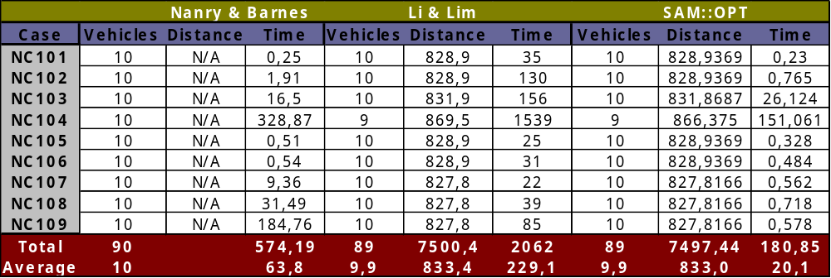
Empirical Investigation on PDPTW
Results - 100-order cases by Nanry & Barnes
Nanry & Barnes: Reactive Tabu Search
Li & Lim: Simulated Annealing with Restarts
1 new “Best until now” result
Rapid convergence to best solution
These are “easy” problems

Slide 24
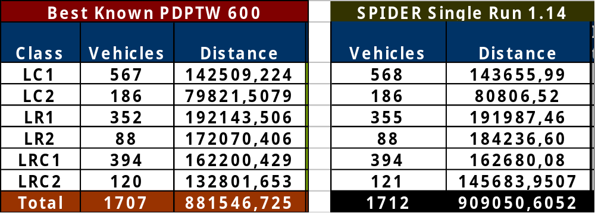
Empirical Investigation on PDPTW
Results - 600-order cases by Li, Lim & Huang
Best known result in 42 of 60 cases
Best known result in 30 of 60 cases with single run
  0.3 % more vehicles, 3 % increase on distance
Time until last improvement: 17 - 17.000 CPU seconds
100 customer: 0,062 - 8310 CPU seconds (LL&H: 27-4200)

Slide 25
Empirical Investigation on PDPTW
- Motivation and Model
Motivation: Assess performance on standard benchmarks
Single depot, identical vehicles
Pickup and Delivery orders
Causal precedences
Coupling constraints
Time windows on pickups and deliveries
Objective: #vehicles, distance (waiting time)
Fairly “poor” model

Slide 26
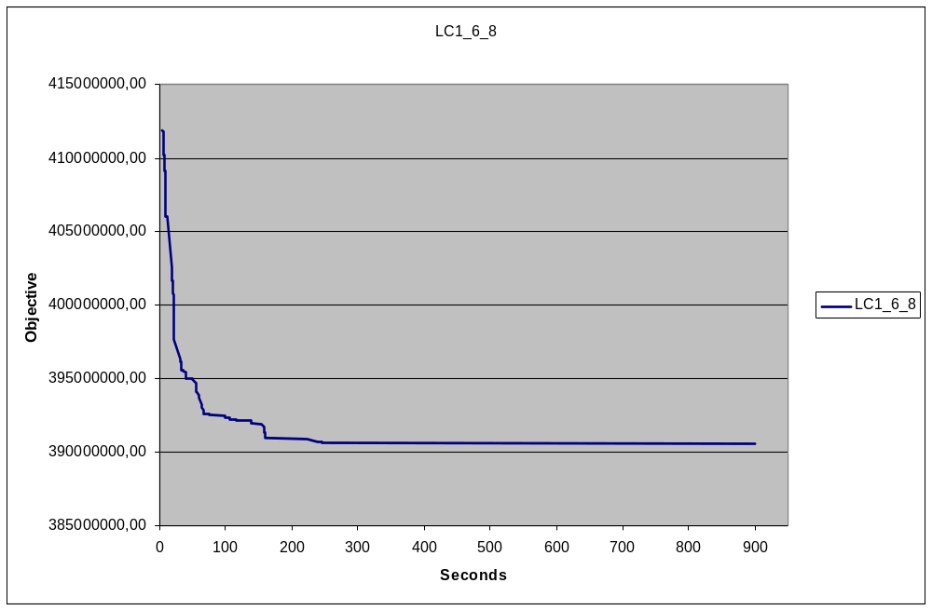
Convergence - LC1_6_8

Slide 27
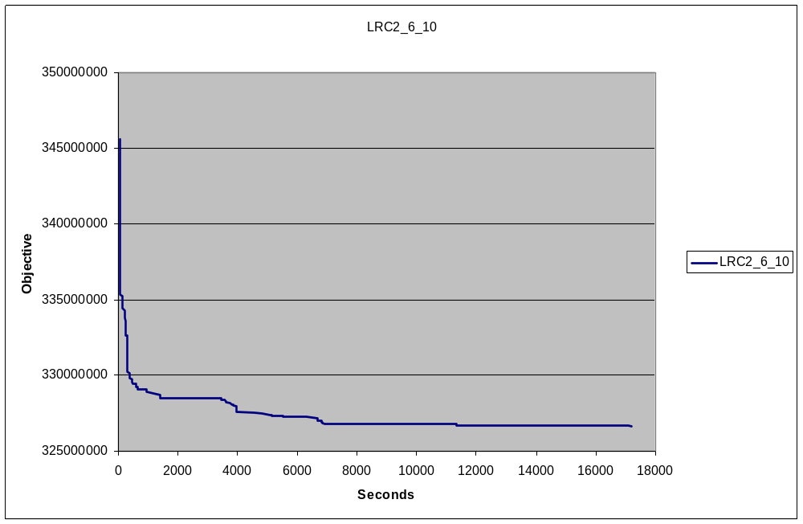
Convergence - LRC2_6_10

Slide 28
Empirical Investigation on PDPTW
Results - All cases by Li, Lim & Huang
Best known result in 273 of 354 cases
Reduction in #vehicles (relative to best known by others):
  100: 2
  200: 7
  400: 21
  600: 37
  800: 99
  1000: -9 (6 of 60 cases amount to -47 vehicles)
Time until last improvement varies a lot
Not many competitors ...

Slide 29
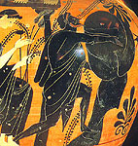
Observations and Reflections (1)
Rich Models are a pain ...
Sisyphos has an easy task ...
There should be more competition on the PDPTW
Better methodologies should be developed for
investigation of rich VRPs

Slide 30
Observations and Reflections (2)
Iterative improvement with VNS is robust
  initial solutions with different quality converge to similar quality solution
More time in construction phase may still be well spent ...
Bent & Van Hentenryck Tour Reduction works well
The optimal sequence of operators does not seem to exist
  ... but some sequences are more robust than others
  … more qualified and dynamic operator selection is a good idea
  … macro-operators seem to be a good idea
Some neighborhoods are very large, filters work well
  1000-case PDP: millions of neighbors, >99% removed by cheap filters
  ... but we may want to navigate infeasible space
Neighborhood selection and exploration
  more flexibility needed
  potential for efficiency gains

Slide 31
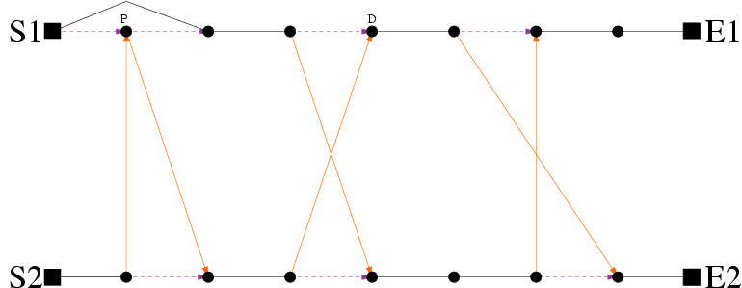
Observations and Reflections (3)
General vs. tailored approach
Current general approach is “brute force”
Effort is wasted on exploring futile moves
One should draw more upon search guidance from:
  overall analysis of problem at hand
  search history (learning)
  analysis of current situation
  opportunistic search control
Exchange

Slide 32
Ongoing work - Improvements
Construction phase
  explore alternative initial solutions
  new construction method for rich VRPs
Tour depletion phase
  what works well - and why
  new ideas
Iterative improvement phase
  More sophisticated VNS strategies
  Computationally cheap operators - run more frequently - run to local optimum
  Computationally expensive operators - focus on interesting moves, filtering and sorting, increase size of neighborhood, “preemption”
  More flexibility and efficiency in neighborhood selection and exploration
  Selection of where to go next, based on:
    near history
    analysis of current solution
  Metaheuristics
    Global level
    Local level
Post-processing phase

Slide 33
Work ahead
More focused neighborhoods
Macro-operators
Opportunistic search control
Parallelism
Research on search landscape topologies
More work on industrial cases
  Publish cases and results
  Benchmark generators
Experiments on “poorer” models such as VRP(TW)
A conceptual model for Rich VRPs
  Nomenclature
  Basis for description language
  Exchange of problem definitions and instances
  Software development
http://www.top.sintef.no/

Slide 34
Summary and Conclusions
VRP highly interesting and important
Many variants, huge literature, idealized models
More work needed on Rich VRP Models
VNS-based algorithmic approach seems
  robust
  effective
Potential for improvement
  Opportunistic search control
  More focused exploration of neighborhoods
  Hybrid methods
  Parallelism
Road short between research and improvements in industry
TOP http://www.top.sintef.no/

Slide 35
Heuristics for Rich VRP Models
Geir Hasle Ph.D.
Senior Scientist, Department of Optimization, SINTEF Applied Mathematics
Assistant Professor, Department of Informatics, University of Oslo
ROUTE2003
Skodsborg, Denmark June 24 2003

Slide 36
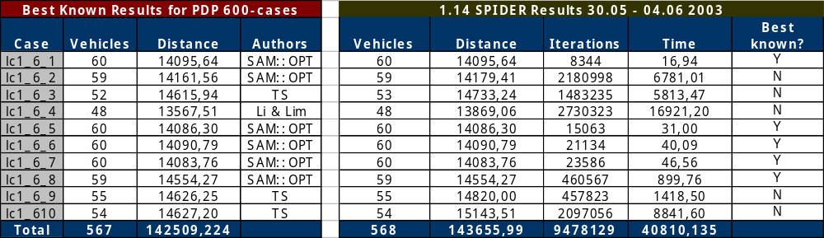
Li & Lim 600-customer PDPTW - LC1
(4 ms per iteration)

Slide 37
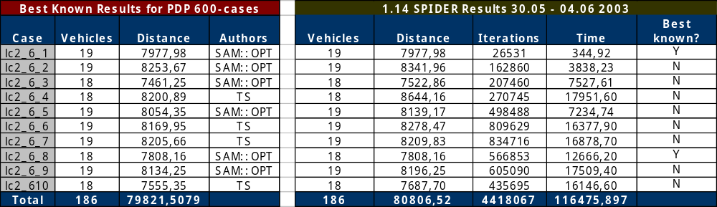
Li & Lim 600-customer PDPTW - LC2
(25 ms per iteration)

Slide 38
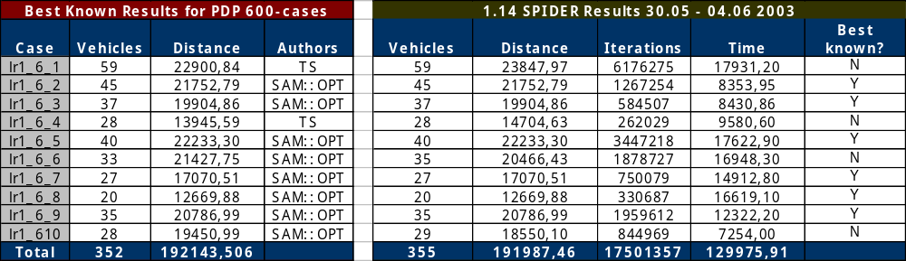
Li & Lim 600-customer PDPTW - LR1
(7 ms per iteration)

Slide 39
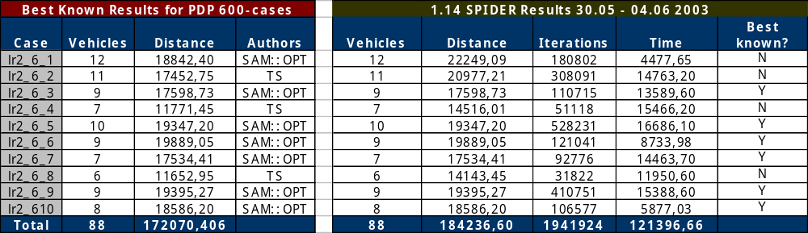
Li & Lim 600-customer PDPTW - LR2
(60 ms per iteration)

Slide 40
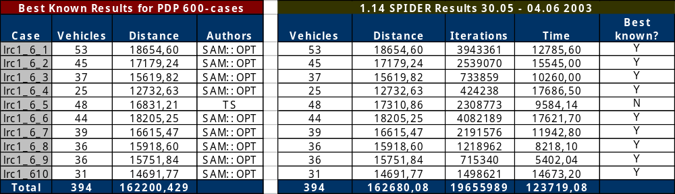
Li & Lim 600-customer PDPTW - LRC1
(6 ms per iteration)

Slide 41
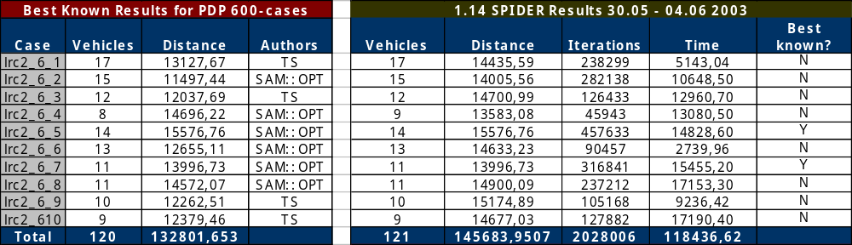
Li & Lim 600-customer PDPTW - LRC2
(60 ms per iteration)

Slide 42
Dimensions of Richness (1)
Type of Operation
  # depots, transshipment points, multi-modal transportation
  more than one trip
  demand splitting
  FTL / LTL
Type of Demand
  pickup, delivery, backhauling, mixed PDP, service engineer
  on node, on arc, mixture
  deterministic / stochastic
  periodic
  inventory
  priorities
  partial satisfaction / split deliveries
  type of cargo

Slide 43
Dimensions of Richness (2)
Scheduling Constraints
  hard time windows
  soft time windows
  lateness
  multiple time windows
  tour duration
  service times
  waiting time
  working time regulations
Vehicles / fleet
  (in)homogeneous
  compartments, trailers, special equipment
  capacity dimensions
  loading / unloading constraints

Slide 44
Dimensions of Richness (3)
Drivers
  labor restrictions
  start and finish times and locations
  multiple drivers, driver exchanges
  expertise, certificates, known regions
Transportation Network
  Euclidean, Manhattan, Shortest Path
  weight, height, length restrictions (time varying)
  one-way streets, turning restrictions
  variable speed, road type
  time dependent travel times
  road closure
  ferries
Dynamics

Slide 45
Dimensions of Richness (4)
Compatibility constraints
  order-order (compartment, sequencing, cleaning)
  order-vehicle (equipment, capacity)
  order-driver (certificates, hazmat)
  vehicle-customer (loading / unloading)
  vehicle-driver (certificates)
  driver-customer
Precedence constraints
Objective components
  # vehicles
  driving time
  driving cost
  distance
  waiting time
  vehicle utilization
  single/multiple objectives

Slide 46
Classical VRP(TW)
Deliveries from a depot
Homogeneous fleet
Sizes/capacities
Single time windows

Slide 47
Classical PDP(TW)
Pickup and delivery at customer locations
Homogeneous fleet
Sizes/capacities
Single time windows

Slide 48
Generalisations
Mixed order types
Non-homogenous fleet
Arbitrary tour start/end locations
Linked tours
Non-Euclidean, asymmetric, dynamic travel times
Multiple time windows (MTW)
Capacity in multiple dimensions
Alternative locations
Alternative time windows

Slide 49
Task
Basic unit in the plan. A ‘stop’, ‘visit’, …
Used both for start/end of tours and for pickup/delivery
Specified by:
  One or more alternative locations
  One or more alternative time windows (may be multiple)
  Two possible durations
  Size of goods to pickup/deliver
In plan:
  One location and time window is selected
  Duration determined by previous location

Slide 50
Order
Different types:
  Delivery
  Pickup
  Direct (P&D)
  Service
Plan structure:

Slide 51
Tour
Time windows and locations given by start/stop tasks
Selected vehicle and driver
Linked tours
  (may have different vehicles)

Slide 52
Anywhere
A special location that causes no extra travel cost/time
Use for orders and tour start/stop
?

Slide 53
Size/Capacity
Measured in a number of dimensions
E.g. weight and volume
Each dimension independent in addition and subtraction
Must fit in all dimensions when comparing size of goods with capacity of vehicle

Slide 54
Vehicle
Capacity
Travelling attributes
  Speed
  Height, weight, length
  Obey one-way?

Slide 55
Driver
Used in work regulations

Slide 56
Objectives (Cost elements)
Travel cost
Tour usage cost
  Cost for starting a tour
  Cost per order on tour
Cost for unserviced order
Waiting time cost
Cost for alternative locations
Cost for same/different location
Cost for breaking work regulations

Slide 57
Constraints
Consistency
  Complete order
  Pickup/delivery same tour and precedence
Time
  Travel time
  Time windows
  Duration
Vehicle capacity
Total capacity over a set of tours

Slide 58
Constraints
Compatibility tour/order tour/location
Orders on same tour
Corresponding locations
  Order: Choose corresponding locations for pickup and delivery task
  Tour: Choose corresponding locations for start/stop tasks
Corresponding time windows for sets of orders
  E.g. Delivery day 1,3,5 or day 2,4,6

Slide 59
Locks
Prevent optimiser changing part of plan
Task: Time lock
Tour: Lock whole or initial part of tour
Order: Lock (un)assigment

Slide 60
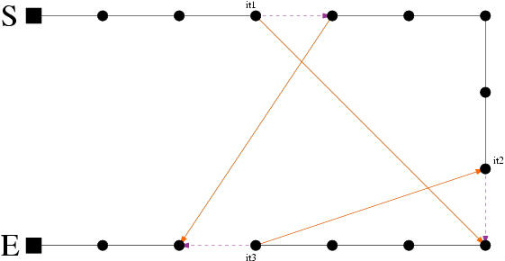
3-opt
Intra-tur
7 muligheter
Rask (ganske)
Ikke veldig effektiv

Slide 61
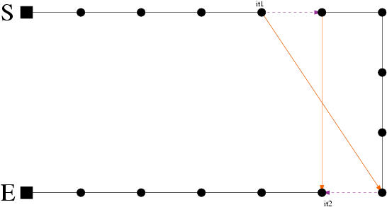
2-opt
Intra-tur
Spesialtilfelle av 3-opt
Rask
Effektiv

Slide 62
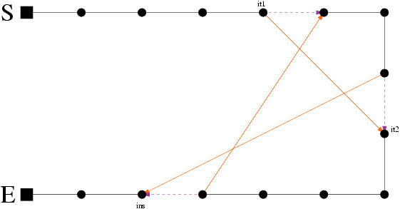
Or-opt
Intra-tur
Spesialtilfelle av 3-opt
Rask
Ikke så effektiv som 2-opt

Slide 63
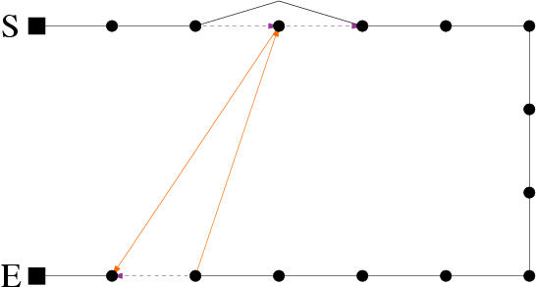
Relocate
Intra-tur og Inter-tur
Middels rask
Effektiv
Intra-tur

Slide 64
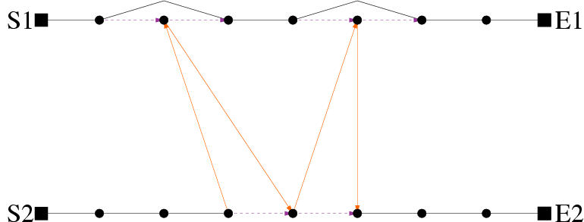
Inter-tur

Slide 65
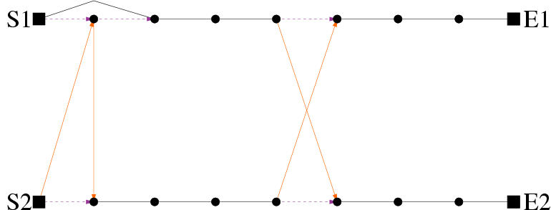
Cross
Inter-tur
Litt treg
Ganske effektiv

Slide 66
Exchange
Inter-tur
Treg
Effektiv (men ikke i forhold til tidsforbruk)

Slide 67
Insert
Setter inn ordre som er “unserviced” på beste mulige sted i turene
Rask
Effektiv (stor gevinst ved å redusere antall “unserviced” ordre)

Slide 68
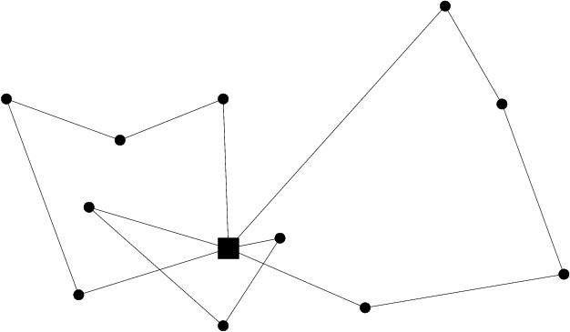
Tour-depletion
Redusere antall turer
Rask
Effektiv (stor gevinst ved å fjerne en tur)
Tre initielle
turer

Slide 69
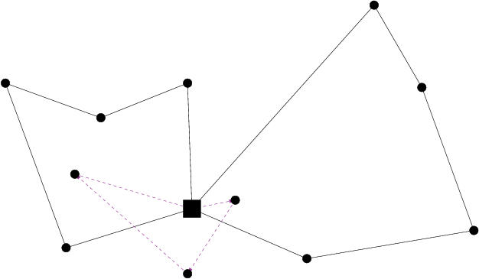
En tur
fjernes

Slide 70
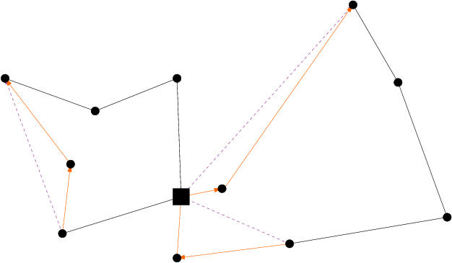
“Unserviced”
ordrene settes
inn i de to andre
turene

